Slide 1
A HIGH-PERFORMANCE IPV6 LOOKUP ENGINE ON FPGA
Author : Thilan Ganegedara, Viktor Prasanna
Publisher : FPL 2013

Slide 2
Based on the statistics collected from real-life backbone IPv6 routing tables, we propose a partitioning algorithm that creates both disjoint and balanced preﬁx groups. For each partition a range tree is built to perform IPv6 lookup.
These range trees are mapped onto independent pipelines on FPGA such that for a single IPv6 lookup, only one partition is active.

Slide 3
Disjoint Grouping of Preﬁxes
1. partitioning using the initial bits of the preﬁxes.
2. grouping by algorithm1

Slide 4
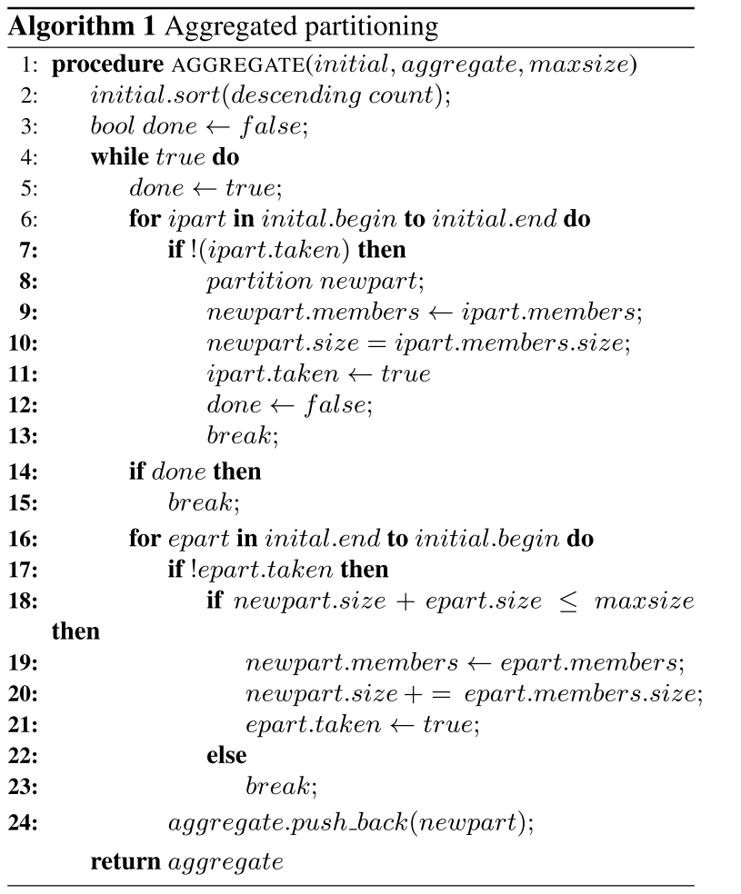

Slide 5
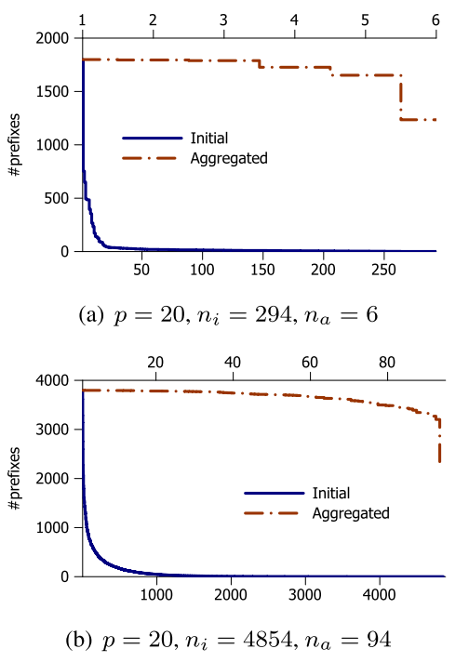
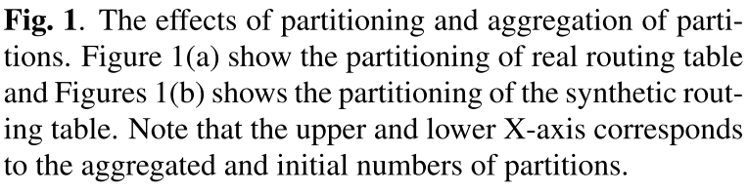

Slide 6
HARDWARE ARCHITECTURE
The basic building block of the hardware architecture is a linear pipeline. Each stage consists of a Processing Element (PE), a stage memory and stage registers.
For high performance, we further pipelined a PE such that the key comparison stage and the memory access stage are pipelined internally. This signiﬁcantly improves the performance while adding little logic overhead.

Slide 7
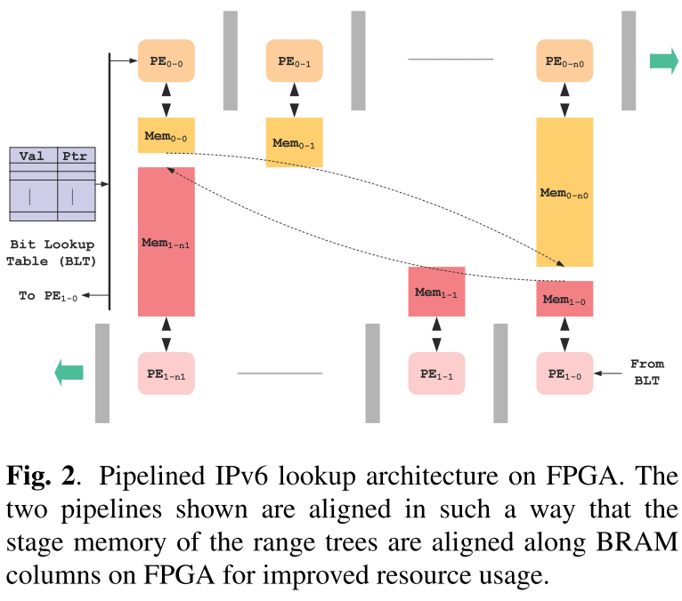

Slide 8
Each sub-tree has an exponential memory distribution since the range tree discussed here is complete . Therefore, each level k has exactly 2 ^{k} nodes, with exception for the last level.
The block memory on FPGA is arranged as vertical columns along the chip and the pipeline stages can be aligned along these vertical columns to take advantage of the resource distribution of the chip.

Slide 9
The architecture was implemented on a Xilinx Virtex 7 X1140V FPGA and the post place-and-route results are reported here.
used both distributed and block RAM available on FPGA to facilitate higher scalability.
The considered chip has 84 Mbit total memory available.

Slide 10
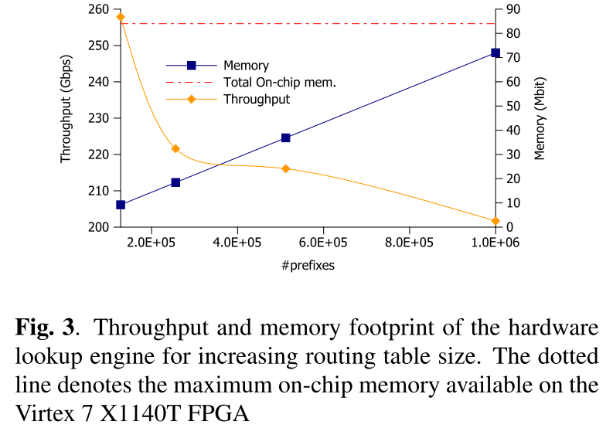

Slide 11
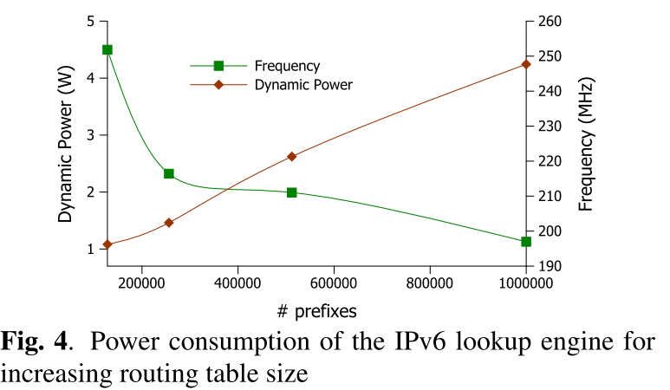

Slide 12
